Slide 1
Marijuana Use: No Longer Down in the Weeds
Jim Hedlund
Highway Safety North
GHSA Annual Meeting
September 18, 2017
Louisville, KY

Slide 2
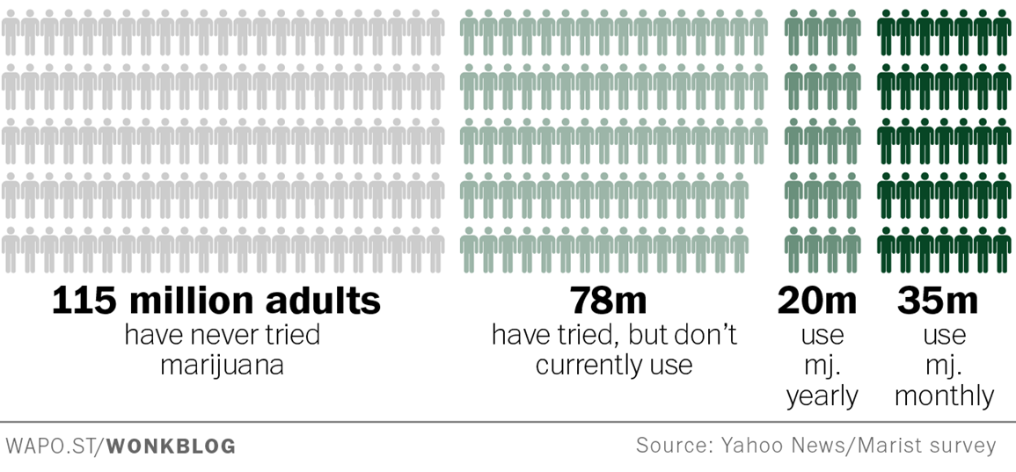
Current marijuana users
Almost one quarter of adults use marijuana

Slide 3
Beliefs about marijuana risks

Slide 4
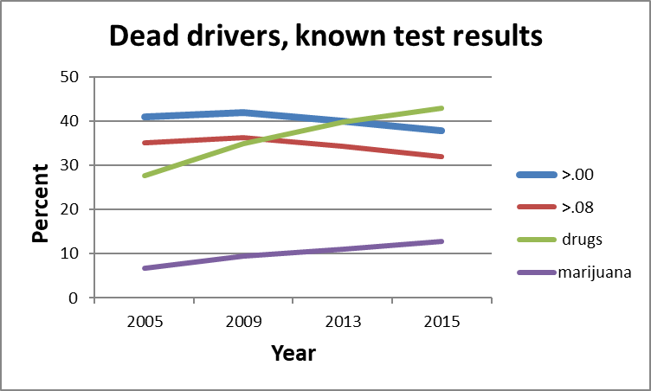
Marijuana in fatally-injured drivers
Drugs increasing; marijuana increasing; alcohol decreasing

Slide 5
Marijuana in Arrests, Crashes
NHTSA roadside survey, 2013-14
12.6% of drivers on weekend nights compared to 8.3% with positive BAC
Colorado, drivers in fatal crashes positive for marijuana
2006: 4.0%
2009: 6.4%
2012: 9.6%
2015: 12.1%
Washington, impaired drivers positive for THC
2009: 18.2%
2012: 18.6%
2016 nine months: 33.2%

Slide 6
Marijuana Crash Risk
Experimental studies: effects on behavior related to driving
Reaction time, judgment, …
Crash studies:
Rogeberg and Elvik meta-analysis: 22-36% increase
NHTSA crash risk study: 25% increase, mostly related to factors such as age and gender
National Academy of Sciences: “increased risk” (no specific estimate)
Asbridge, Hartman and Huestis: nearly 100% increase
Aydelotte et al. 2017: FARS data from CO and WA after legalization: no significant changes in fatality rates

Slide 7
Marijuana Laws
Recreational marijuana now allowed in 8 states and DC
Voters approved in CA, MA, ME, and NV in 2016
Previously legal in AK, CO, OR, WA, and DC
Medical marijuana now allowed in 29 states and DC
Up from 23 in 2015
West Virginia law signed April 19, 2017; use allowed July 1, 2019
Marijuana use decriminalized in 21 states and DC
Up from 20 in 2015; these include recreational states
Canada considering legalizing marijuana use
NCSL, August 2017

Slide 8
