Slide 1
Tribal Participation in South Dakota Highway Safety
2017 GHSA Annual Meeting
Louisville KY

Slide 2
Did you know?
Native Americans cultivated and developed many plants that are very important in the world today, including white and sweet potatoes, beans, tobacco, chocolate, peanuts, cotton, rubber and gum. They were also the first to make popcorn.

Slide 6
New FAST Act Provision:
(10) POLITICAL SUBDIVISIONS.—A State may provide the funds awarded under this section {§405} to a political subdivision of the State or an Indian tribal government.’’

Slide 7
Standing Rock Sioux Tribe:
North and South Dakota jointly funded project to fund a tribal highway safety specialist
Relationship between states and tribe is good but the project has had its occasional bumps in the road – a large learning curve for parties

Slide 8
Oglala Sioux Tribe (Pine Ridge):
Been involved consecutively for the past four years

Slide 9
Oglala Sioux Tribe (Pine Ridge):
Unlike the State of South Dakota, the OST has a primary seatbelt and child passenger seat law
Seatbelt fine = $35.00 per passenger + court cost
Child Passenger Seat fine = $250.00 + court cost

Slide 10
Oglala Sioux Tribe (Pine Ridge):
BAC drops from 0.10 to 0.08 with increased fines & jail
DUI cannot be dismissed during plea negotiations
Officers use statewide TraCS crash tool & ticketing
Select officers are child passenger seat certified techs
Seatbelt surveys conducted twice annually
Driver belt use has risen from 35% in 2011 to 61% in 2017
Lots of school presentations, roll over simulator, etc…

Slide 11
Did you know?
In 1850, there were an estimated 20,000,000 buffalo on the plains between Montana and Texas, for which the Plains tribes depended upon.
By 1865, just fifteen years later, they had been almost completely exterminated by sports and hide hunters.

Slide 12
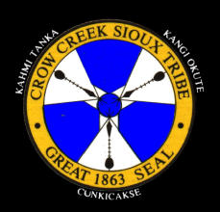
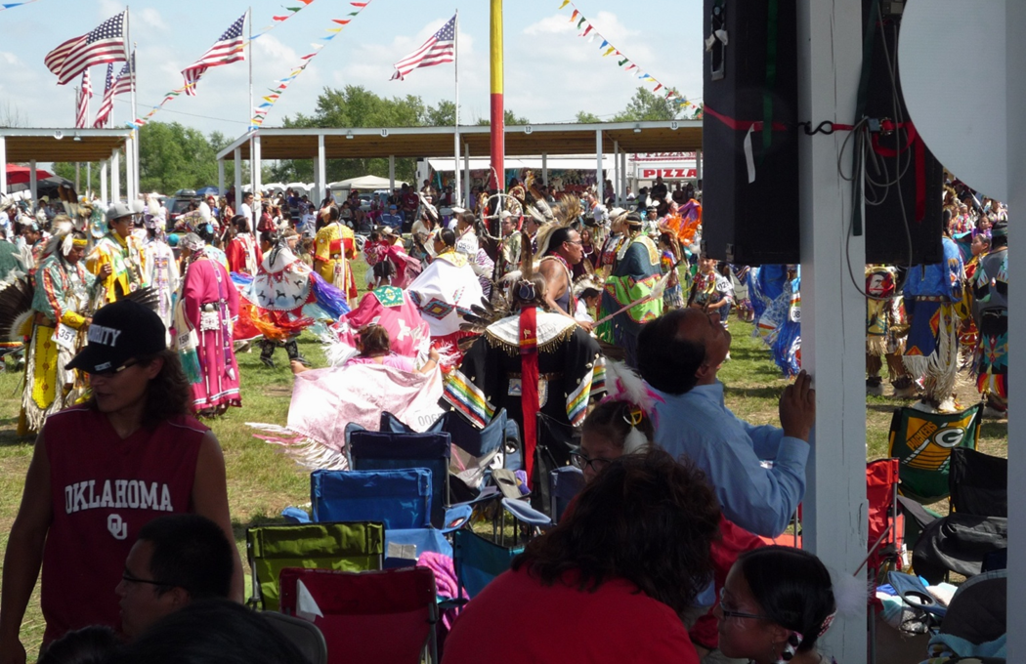
Crow Creek Sioux Tribe
South Dakota Highway Patrol & Crow Creek Annual Powwow Memorandum of Understanding

Slide 13
Crow Creek Sioux Tribe
Tribal Powwows create a time and place for families to unite.
Powwows also create a connection to cultures and identities.

Slide 14
Crow Creek Sioux Tribe
Although the South Dakota Highway Patrol has always had a working relationship with various tribal partners, the arrangement was more “reactive” than “proactive”
In August 2013, the Crow Creek Tribe and the SDHP formed a partnership to allow troopers to assist with enforcement activities at the annual Tribal Powwow.

Slide 15
Crow Creek Sioux Tribe
This historic decision did more than keep officers and the public safe, more than deter criminal behavior; it allowed troopers to see and understand a culture from a different perspective. It allowed tribal members to see troopers as people; compassionate and real, not just enforcers of the law.
This four-day team effort proved to be much more than two agencies coming together; it was two cultures communicating and learning.

Slide 16
Crow Creek Sioux Tribe
Troopers were sworn-in and given authority to enforce tribal laws for the four-day event.

Slide 17
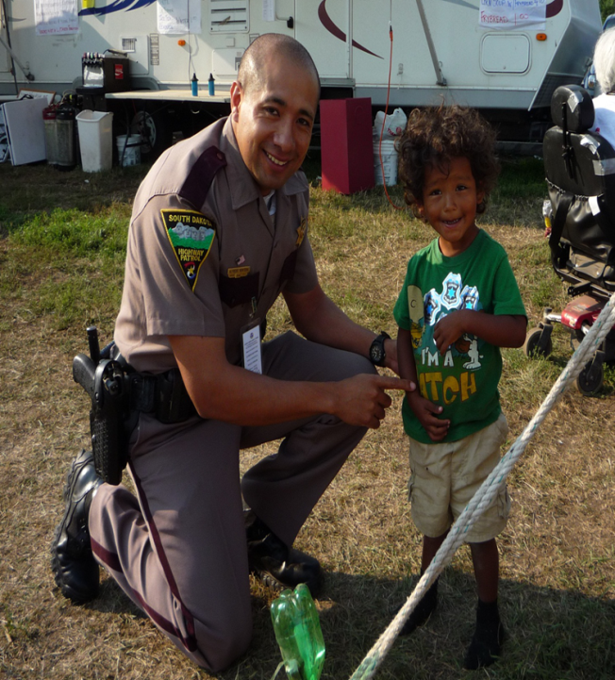
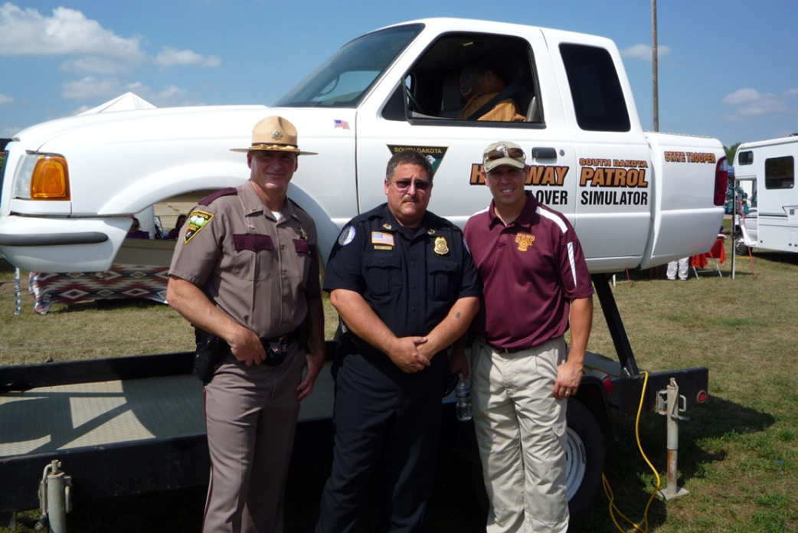
Crow Creek Sioux Tribe

Slide 18
Crow Creek Sioux Tribe:
Unfortunately, the productive partnership is suspended at this time.

Slide 19
Lessons Learned:
Relationships between State and Tribes require ongoing effort and grooming
Even with that effort – unrelated issues can affect the relationship
It is worth rekindling the relationships

Slide 20
Lessons Learned:
The Native American culture is steeped in respect for faith, tradition, elders, forgiveness, patriotism and nature.
We need to keep trying to form partnerships with this important culture.

Slide 21
Did you know?
Native Americans were not given citizenship until 1924.

Slide 22
Lee Axdahl – Director
South Dakota Office of Highway Safety
lee.axdahl@state.sd.us

