Slide 1
Factors in Traffic Fatality Fluctuations
G
Governor’s Highway Safety Association
2017 Annual Conference
Safety Association
2017 Annual Conference

Slide 2
Past: What did the great recession tell us about traffic safety?

Slide 3
Traffic fatalities = Risk × Exposure
Miles travelled decreased.
But not enough to explain decrease in traffic deaths.
Fatal crash risk declined.
But why?

Slide 4
Broad range of vehicle, driver, environment, & economic factors considered
Safety belt laws & use rates
ESC, crashworthy vehicles in the fleet
Motorcycle helmet laws & use rates
Child restraint laws.
Cell phone & texting laws; observed usage rates.
DUI laws (BAC, fines, suspension, etc.)
State expenditures on
Capital improvements
Maintenance
Admin/Research/Planning
Law enforcement & safety ed.
HSIP projects
Fuel price & fuel tax
Alcohol consumption per capita, for beer, wine, & spirits.
Economic measures
GDP per capita
Median income
Labor force
Employment size & rate, by age & sex
Unemployment size & rate, by age & sex
Exposure measures:
VMT, by road type & by vehicle type
Vehicle registrations by type
Population by age group
Road miles, by type

Slide 5
Economic factors were primary in driving the 2007-2011 decline

Slide 6
Most improvements in traffic safety are incremental and are expressed gradually over time
Long-term downward pressure on traffic fatalities:
Vehicle: e.g., penetration of crashworthy designs, crash avoidance technologies such as electronic stability control.
Driver: e.g., graduated driver license, increased use of safety belts, enforcement, safety campaigns to change behavior.
Environment: e.g., improved roadway design, barriers, signs, guardrails, rumble strips.
Economic changes can effect substantial changes in driver behavior over the short term.
Less travel by risky drivers
Less travel in risky environments

Slide 7
Motor Vehicle Fatal Crash Overview
Terry Shelton
GHSA Annual Meeting
Louisville, KY
September 18, 2017

Slide 8
Summary Fatality Statistics, 2015
35,092 people died on our highways
an increase of 7.2% from 2014
Vehicle Miles of Travel increased by 3.5% from 2014
Fatality rate increased to 1.13 in 2015 from 2014
Pedestrian fatalities up 9.5%, highest since 1996.
Pedalcyclist fatalities up 12.2%, highest since 1995.
2016: Fatalities up 8.2% for first nine-months of 2016
Notes:
Just a decade ago, in 2006, there were 42,708 traffic fatalities, and more than 40,000 each year during the decade prior to that.

Slide 9
44,525
35,092
Source: FARS, FHWA

Slide 10
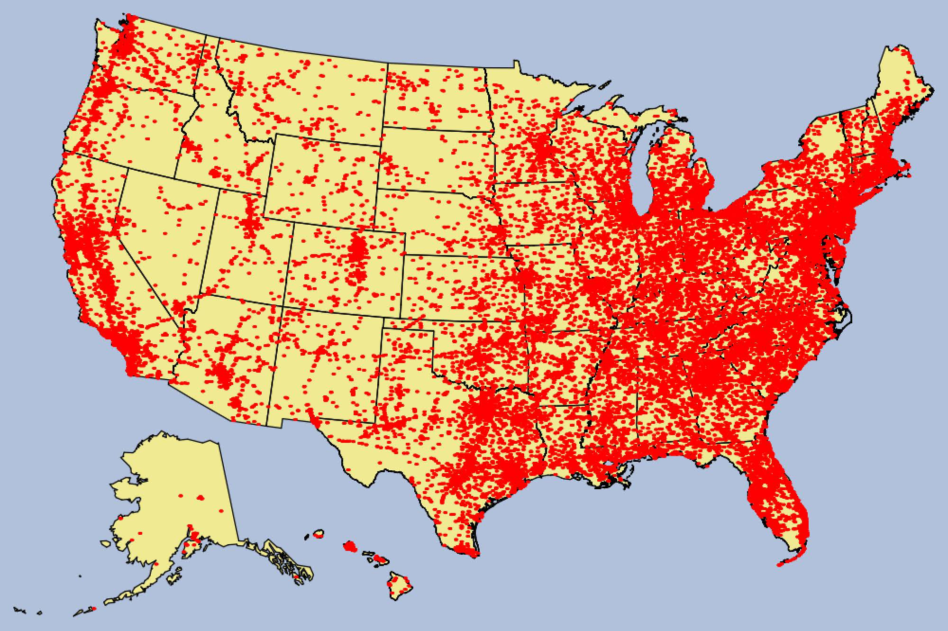
Fatal Crashes in US, 2015
Source: FARS
32,166 Fatal Crashes

Slide 11
Source: FARS

Slide 12
Human Choices Categories, 2015
Percentage and Number of fatalities:
29% are alcohol-impaired driving fatalities (10,265)
48% of passenger vehicle occupants unrestrained (9,874)
27% are speeding-related (9,557)
10% are distraction-affected (3,477)
Notes:
Just a decade ago, in 2006, there were 42,708 traffic fatalities, and more than 40,000 each year during the decade prior to that.
35,092 people died on U.S. roadways in 2015.
7.2% increase in fatalities in 2015 compared to 2014.
Largest percentage increase in 50 years (1966).
Vehicle Miles Traveled (VMT) increased by 3.5%.
Largest percentage increase in almost 25 years (1992).
Pedestrian fatalities (5,376) up 9.5%, highest since 1996.
Motorcyclist fatalities (4,976) up 8.3%.
Pedalcyclist fatalities (818) up 12.2%, highest since 1995

Slide 13
Source: FARS
Notes:
Increase ranges from 30% in VT to 0.4% in PA.
Twenty-two states had double digit (10% or higher) percent increases from 2014.
Decline ranges from -23% in NM to -0.5% in TN.

Slide 14
Source: FARS

Slide 15
Summary Points
A change from one year to the next does not necessarily indicate a trend
Need to drill down to State and local levels
Need to look beyond fatal crashes---injury crashes, property-damage crashes

Slide 16
Predicted vs. Observed Texas 2002-2016

Slide 17
Predicted – Texas 2017 to 2025
Exposure

Slide 18
Predicted if vehicle safety improvements continue to decrease risk

Slide 19
Programmatic Risk Reduction

Slide 20
Bonus Slide Follows

Slide 21
Texas VMT trends relationship to pedestrian casualties?

