Slide 1
Autonomous Vehicles: Brief Introduction; Traffic Safety Issues for States
Jim Hedlund
Highway Safety North
GHSA 2017 Annual Meeting
Louisville, KY
September 20, 2017

Slide 2
In the next 10 minutes
AV 101
What’s an autonomous vehicle (AV)?
What’s on the road now?
What’s coming and when?
What does the public think about AVs?
What are current state laws on AVs?
Traffic safety issues for states
AV testing
AV operations
What should states do
What should national organizations do
2

Slide 3
Report released Feb. 2, 2017
3

Slide 4
What’s an AV?
Level 0: no automation, driver in complete control
Level 1: driver assistance
Cruise control or lane position, driver monitors at all times
Level 2: occasional self-driving
Control both speed and lane position in limited situations, like Interstates; driver monitors at all times
**************
Level 3: limited self-driving in some situations, like Interstates
Vehicle in full control, informs when driver must take control
Level 4: full self-driving under certain conditions
Vehicle in full control for entire trip, such as urban ride-sharing
Level 5: full self-driving at all times
4

Slide 5
What’s on the road now?
Level 1 available for many years
Adaptive cruise control, lane-keeping assistance
Level 2 available now
Tesla Autopilot
Levels 3-5 coming soon
Waymo (Google) test fleet: 3 million miles as of May 2017
Uber in Pittsburgh, Tempe; Lyft in Boston; pizza delivery in Ann Arbor
37 companies with AV testing permits in CA as of August 2017 – up from 12 in March 2016
By 2020: available (perhaps) from Audi, BMW, Ford, Tesla, Volvo, VW; Delphi, Lyft, NuTonomy, Uber, Waymo …
5

Slide 6
What’s coming and when?
6

Slide 7
What does the public think about AVs?
Skeptical
Prospect of wide use? 34% excited, 57% worried
Will AVs reduce crashes? 35% yes, 46% no
Would you ride in an AV today? 17% yes, 75% no
Would you buy an AV when available? ≈ 20% yes, ≈ 50% no
Prefer AVs that allow drivers to take control
Over 80% in two surveys
5 surveys (4 in 2016 and 1 in 2015), 4 in US and 1 in Canada
7

Slide 8
What are current state laws?
AVs probably can operate in most states without law changes
AV laws in place in 20 states and DC as of August 2017
CA, DC, CO, FL, MI, NC, NV, TN, TX: testing and operations
AR, CT, NY: testing
AL, ND, UT, VT: study
GA, LA, PA, SC, VA: other (such as laws regarding platooning)
AV executive orders in 4 states
AZ: testing and operations
MA, WA: testing
WI: study
NCSL August 2017
8

Slide 9
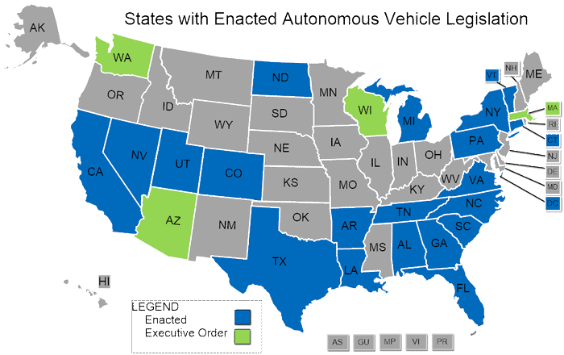
NCSL August 2017
9
Notes:
This shows how quickly states are embracing AVs.
In 2017, 33 states introduced legislation; 20 states introduced legislation in 2016.
California was third to enact an AV law, in 2012, after NV and FL.
CA regs for deployment issued for public comment March 10, 2017
20 states — Alabama, Arkansas, California, Colorado, Connecticut, Florida, Georgia, Louisiana, Michigan, New York, Nevada, North Carolina, North Dakota, Pennsylvania, South Carolina, Tennessee, Texas, Utah, Virginia and Vermont—and Washington D.C. have passed legislation related to autonomous vehicles.
4 state governors - Arizona, Massachusetts, Washington and Wisconsin have issued executive orders related to autonomous vehicles.

Slide 10
State AV priorities - testing
Encourage AV testing while protecting public safety
Some considerations
How and where testing will be conducted
Test driver selection and training
Test vehicle identification
Reporting: overall, incidents, crashes
10

Slide 11
State AV priorities - operations
Encourage AV operations while protecting public safety
AV certification
AV registration and titling
AV drivers
Laws on AV operations
Law enforcement
Crashes: emergency response, crash investigation
New MMUCC data elements for AV crashes
Data systems: how to identify AVs
Liability and insurance
Vehicle inspection
Coordination across states
11

Slide 12
What should states do?
Be informed; stay informed
Be a player
Join or start a state AV task force; include industry partners
Work with other states to develop consistent laws, policies, procedures
Understand state roles
Federal role: regulate vehicles
State roles: license vehicles and drivers, establish and enforce traffic laws, vehicle insurance and liability
Consider AV laws and regulations carefully
Aim for consistency across states
Be flexible
AVs are disruptive technology, developing very quickly
12

Slide 13
What should national organizations do?
Develop model AV laws and regulations
Document the traffic safety issues of AVs
Develop model public education materials
Establish an AV information clearinghouse
Issue vehicle regulations and guidance promptly
Establish regulations or guidelines to identify AVs easily
Involve law enforcement, SHSOs, and DMVs in AV discussions
13

Slide 14
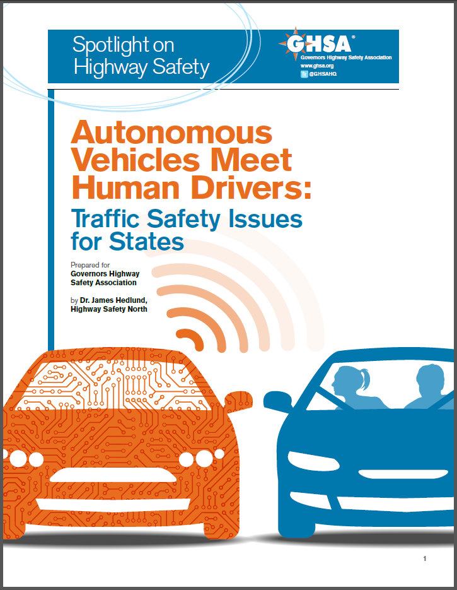
For more information
Jim Hedlund
Highway Safety North
jhedlund@sprynet.com
Download the report: www.GHSA.org
14

