Slide 1
Partners in Highway Safety
DIRECTOR Contact Information

Slide 2
Today’s Highway Safety Discussion
The State Highway Safety Office
Problem Identification
Strategic Planning & the Role of Law Enforcement
Challenges Facing Law Enforcement Leadership
High Visibility Enforcement (HVE)
SHSO Resources for Law Enforcement

Slide 3
The State Highway
Safety Office

Slide 4
State and Community
Highway Safety Grant Program
The Federal Highway Safety Act of 1966:
Created precursor of the National Highway Traffic Safety Administration (NHTSA)
Established Section 402 Grants
Requires a Governor’s Representative for Highway Safety
Established funding for highway safety projects, traffic enforcement and public information and education
Requires a Strategic Highway Safety Plan

Slide 5
PROBLEM
IDENTIFICATION
What do we know?

Slide 6
Vast Majority of Fatal Crashes:
Human Error
Vehicle Failures
(13% of all)
Driver Error /
Human Factors /
Risky Behaviors
(93% of all)
Roadway Factors
(34% of all)
From: AASHTO Highway Safety Manual

Slide 7
Vast Majority of Fatal Crashes:
Human Error
Human Factors that can be Impacted by Law Enforcement:
Speeding and Aggressive Driving
Impairment
Distraction
Failure or Improper Use of Restraints
Other Risky Driving Behaviors
  Red Light / Stop Sign Running
  Failure to Yield
  Drowsy Driving
Driver Competencies

Slide 8
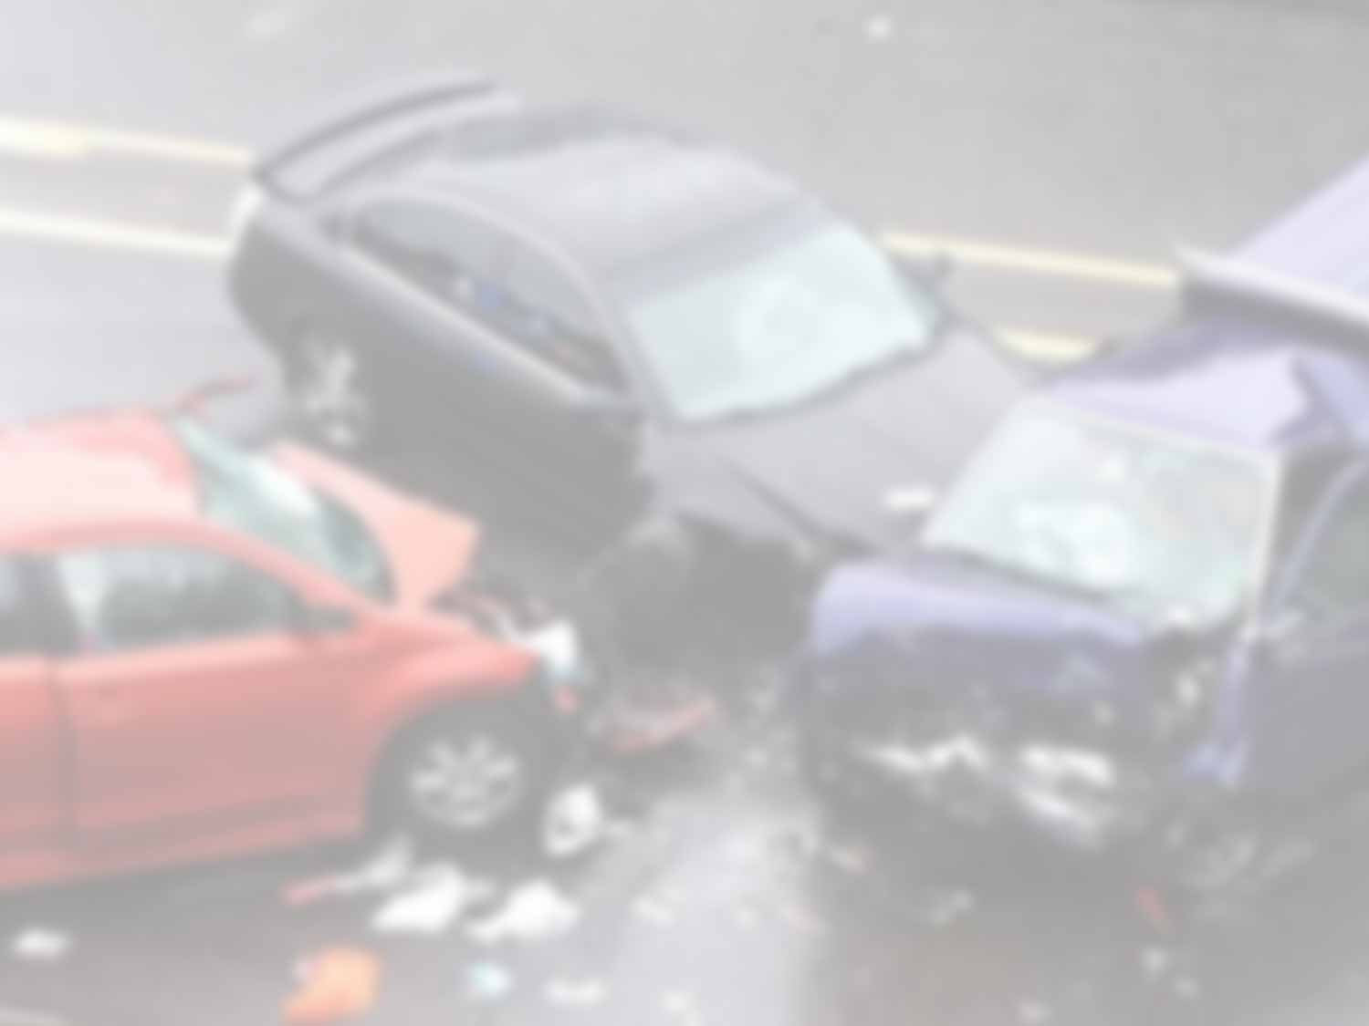
Crashes are caused by the alignment
of factors that can be both
anticipated and altered.
Therefore, crashes are both
predictable and preventable!
They are NOT accidents!

Slide 9
[STATE] Crash Data and Trends
Fatal Crashes by Contributing Factor, 2013-2017
SAMPLE

Slide 10
Strategic Planning and the Role of Law Enforcement

Slide 11

Working Together to Address the Crash Problem

Slide 12

How Many Deaths are Acceptable?
INSERT VIDEO HERE

Slide 13
How Do We Solve the Maze and Eliminate Highway Deaths?
Speeding
Distraction
Drunk Driving
Commercial Vehicles
Pedestrians
Red Light Running
Drugged Driving
Motorcycles
Aggressive Driving
Seat Belts
Bicycles

Slide 14
Effective Highway Safety Programs
Use Interconnected Approaches
Comprehensive Problem Identification
Productive Engineering Strategies
Strict Enforcement
Extensive Public Education
Robust Evaluation and Analysis
Effective Emergency Medical Services

Slide 15

What is Law Enforcement’s Role?
It’s about saving lives in your community!

Slide 16
Strategic Planning Process
Where we are now
Where we want to be
How will
we get there?

Slide 17

Strategic Planning Process:
Our State’s SHSP
Data-Driven Vision
Measurable Goals & Objectives
Executive-Led and Tailored
to the State’s Needs
Emphasis Areas
of Greatest Concern
Strategic Highway Safety Plan
(SHSP)
Performance Evaluation
Measure, Evaluate
and Adjust
Broad-Based Implementation
Using All 4 Es of Highway Safety

Slide 18
Strategic Planning Process:
Law Enforcement’s Role
Providing Executive Law Enforcement Perspective
Collecting Data:
Crash, Citations,
Arrests
Strategic Highway Safety Plan
(SHSP)
Evaluating Outcomes and
Impact
Implementing
Enforcement Strategies and
Countermeasures

Slide 19
Strategic Planning Process Evaluation
How do we measure success?
What separates a plan on the shelf from a successful endeavor?
  Monitoring Performance
  Maintaining Momentum
  Continually Evaluating Progress and
  Making Adjustments

Slide 20

Strategic Planning Process
Requires Leadership Involvement
Executive Law Enforcement Leadership:
Chiefs of Police and/or Sheriffs’ Associations
Traffic / Highway Safety Committees
Potential Traffic / Highway Safety Committee Activities:
SHSP Planning and Implementation Teams
Resolutions of Support
Enforcement Projects
Trainings

Slide 21
A Few of the
Challenges Facing
Law Enforcement Leadership

Slide 22

Leadership Challenges of Today’s Law Enforcement
Balancing current
local issues and sentiments without
losing sight of highway safety considerations

Slide 23
Leadership Challenges of Today’s Law Enforcement
Balancing the need
to keep the community safe vs. the public perceptions of overzealous policing

Slide 24
Leadership Challenges of Today’s Law Enforcement
Addressing the concerns/hesitations
of today’s generational officers relating
to traffic enforcement

Slide 25

What Does Effective Traffic Law Enforcement Look Like?
Outputs are only one small part.

Slide 26
High Visibility
Enforcement
(HVE)

Slide 27
Working through the Traffic Safety Maze with High Visibility Enforcement
Uses place-based and problem-solving policing
Balances public scrutiny with an enforcement need
Works toward goals and objectives within state/regional plans
Highly transparent

Slide 28
High Visibility Enforcement Implementation
Focused on good data and problem identification
Contains performance metrics and specific strategies
Includes pre-established evaluation plan
  Effectiveness
  Outcomes and impacts, NOT only outputs
Extensive media plans before, during and after the campaign (with publicized results)

Slide 29
SHSO Resources for Law Enforcement

Slide 30
Resources for Law Enforcement
Our Strategic Highway Safety Plan:
  www.ourstateSHSP.gov
Our Law Enforcement Liaisons:
  Name/ Region/ Contact Info
  Name/ Region/ Contact Info
Our Program Managers:
  Name/ Program Area/ Contact Info
  Name/ Program Area/ Contact Info
Grant Opportunities:
  www.ourstategrants.gov
SAMPLE

Slide 31

Eliminating
Highway Deaths is a Collective Responsibility
Thank you for your partnership!

